Slide 1
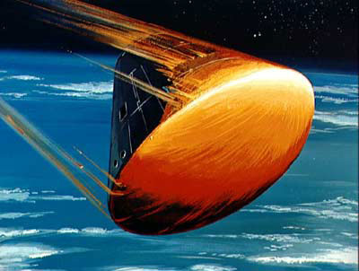
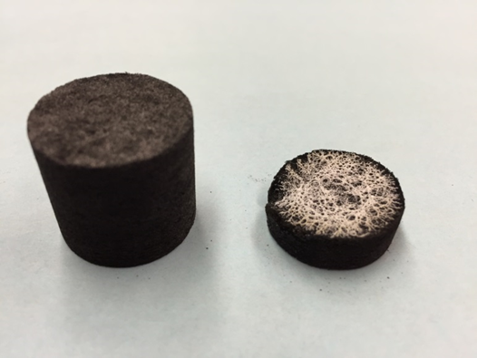
Collecting Experimental Data
for the
Modeling of Reactive Gas and Pyrolysis Interactions with Hot Carbon Chars.
David Thorne: REU Program, SRI International
8/15/2016

Slide 2
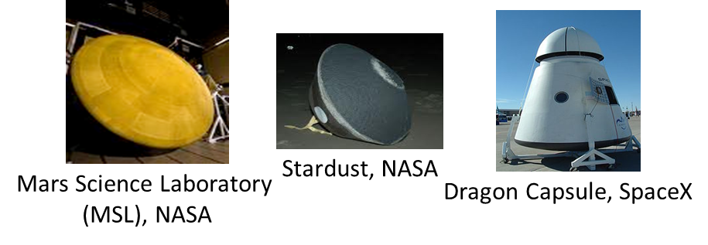
Ablative thermal protection system (TPS) materials are required for the extreme heating encountered during entry into planetary atmospheres.

Slide 3
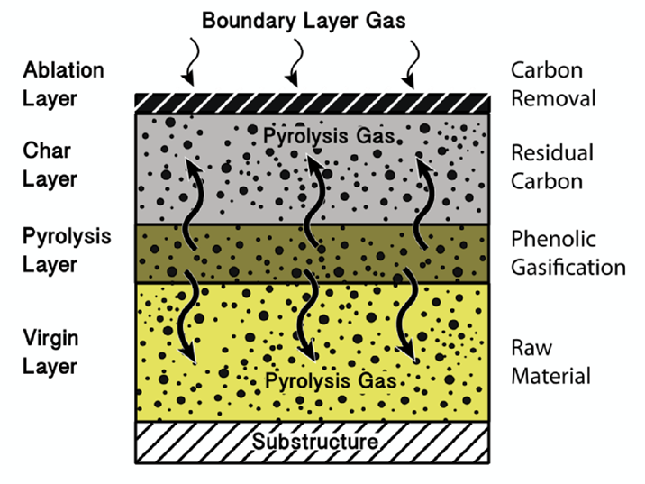
The Ablation Process
A boundary layer is formed from gaseous reaction products within the heat shield material and provides protection against convective heat.
The outer surface of the material chars, while the bulk of the TPS material undergoes pyrolysis and expels product gases.

Slide 4
Why is Research Involving Ablative Materials Desired?
Modern design of heatshields is dependent on experiments performed in the 1960’s;
The physics and chemistry of ablation models are dependent on a limited set of
measurements that were based on outdated techniques.
Tend to overestimate ablation rates, calling for more material than necessary.
The ablation community has expressed the need for modern data on the interactions between
atmospheric gases, virgin carbon material, pyrolysis gases, and hot carbon char.
Research pertaining to the ablative materials used for TPSs, remains one of the main focal points of NASA's technology development.
Project Purpose: We are collecting modern experimental data, used to evaluate models currently used in ablation simulations, and develop new ones

Slide 5
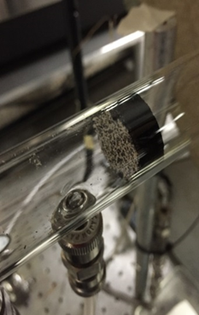
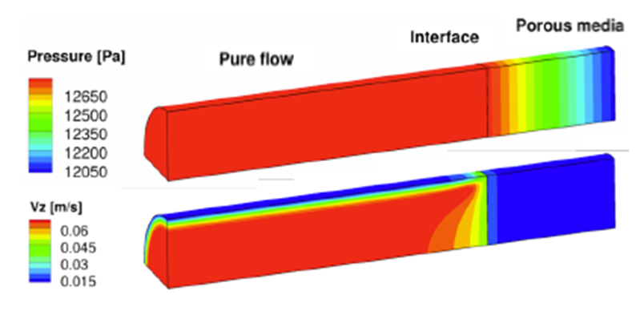
Type of Data Collected
Very simple experimental setup that can be easily simulated using fluid dynamics and material
response codes
Collect temperature, pressure, mass flow, and reaction product data
KATS, Kentucky Aerothermodynamics and Thermal Response System,
Combines fluid dynamics and material response codes in order to simulate chemical interactions with
porous hot carbon chars.

Slide 6
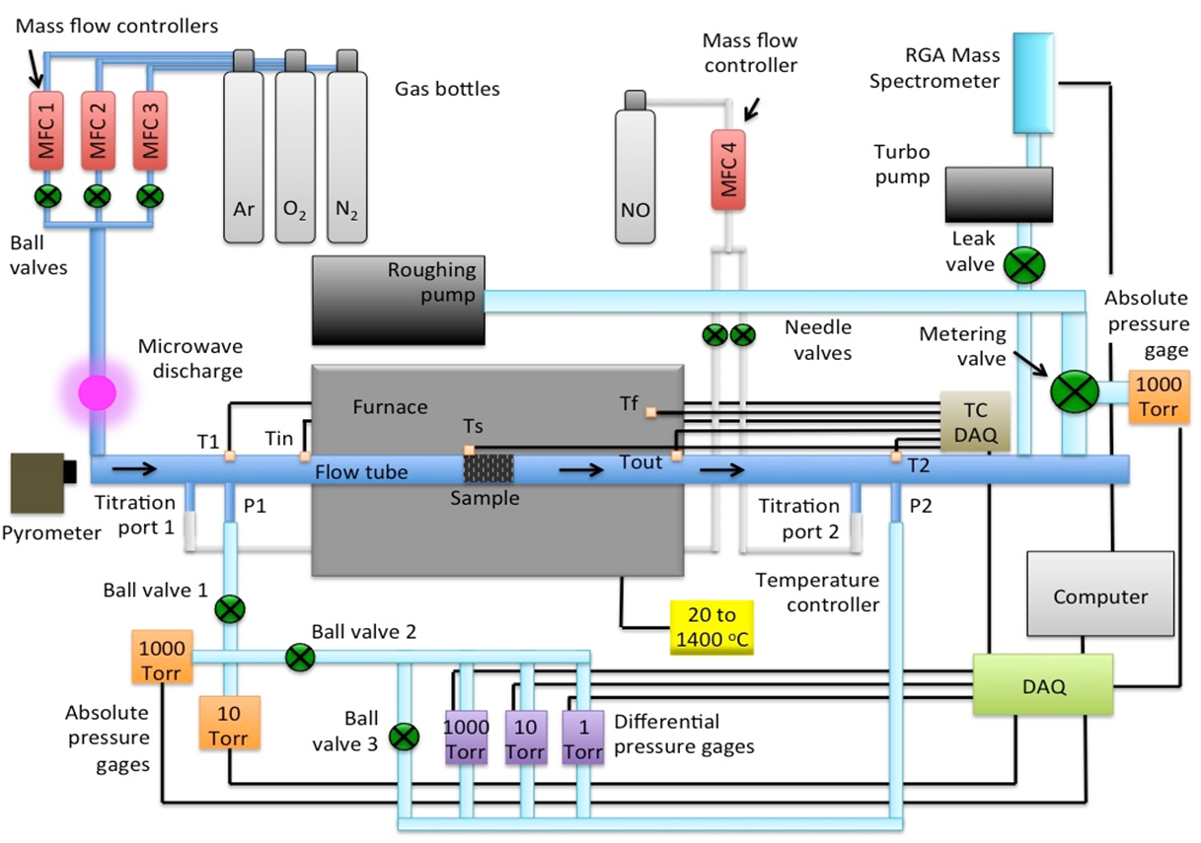
Experimental Setup

Slide 7
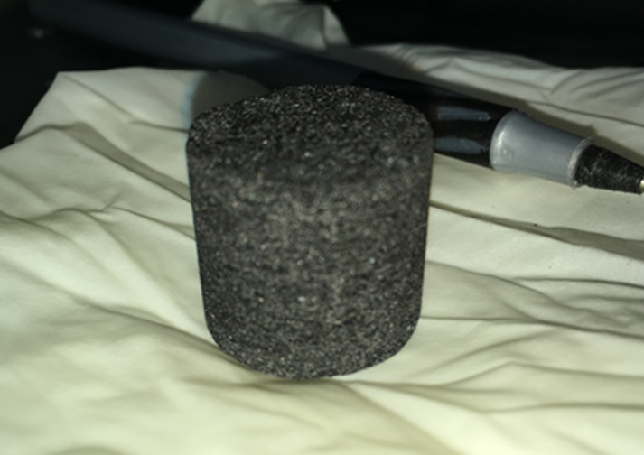
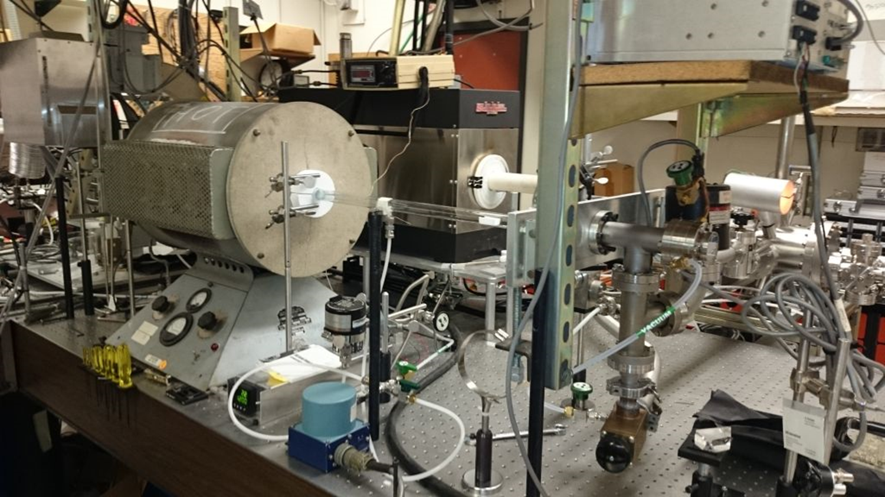
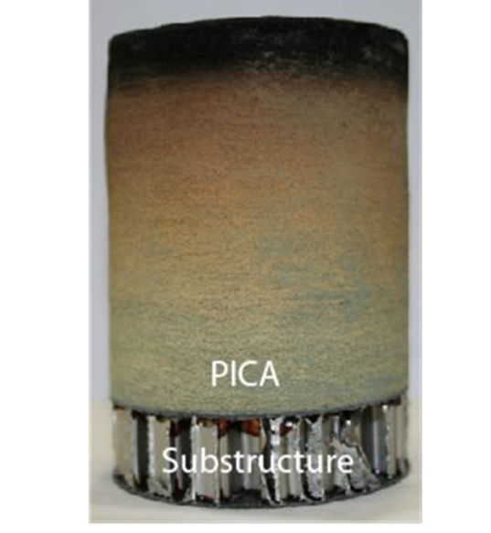
Lab Equipment
FiberForm, manufactured by Fiber Materials, Inc.
A rigid carbon fiber composite used as preform for the carbon/phenolic ablator PICA

Slide 8
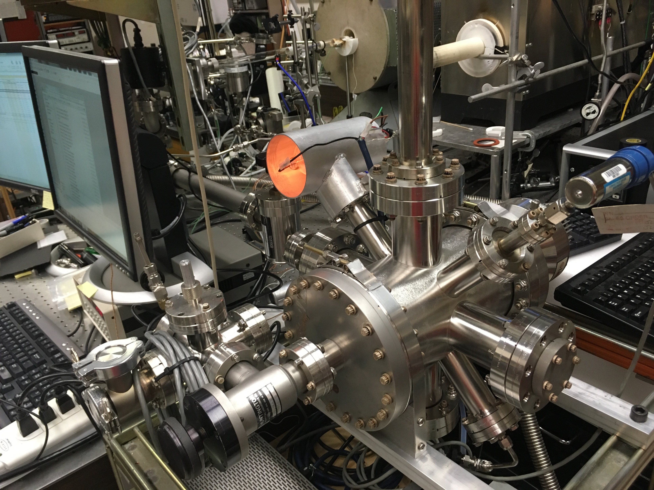
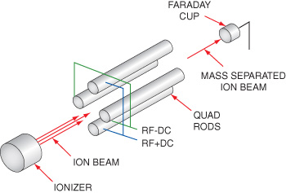
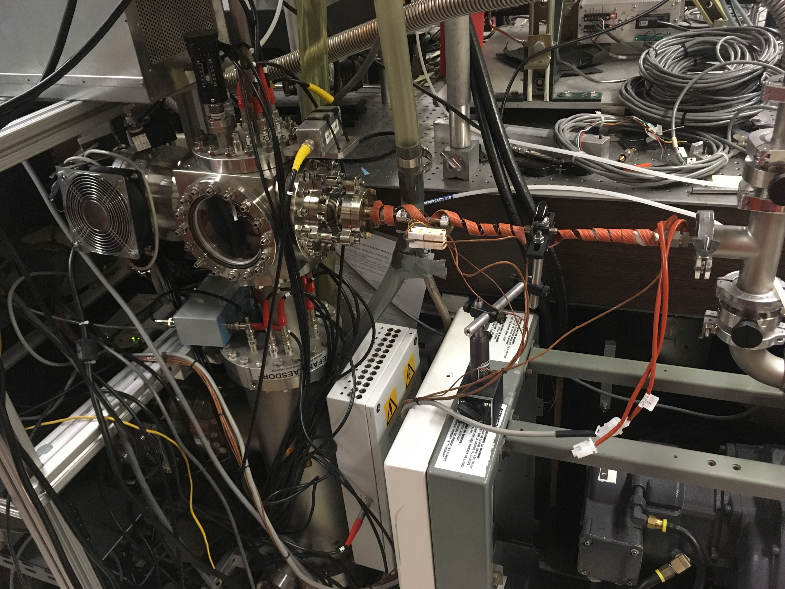
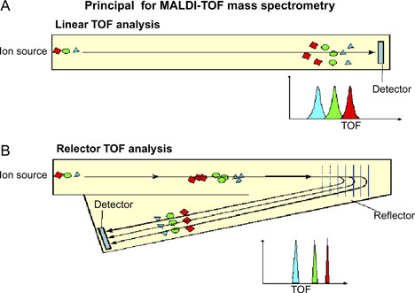
H2O
OH
O2
Long flight path yields
high resolution

Slide 9
Quantification
$$−.0123+1.7∗{10}^{4}X+1.8∗{10}^{7}X^{2}−3.4∗{10}^{9}X^{3}$$

Slide 10
Overview of Experiments
Argon and Helium experiments were performed in order to obtain mass loss not associated with reactions.
O2 is very reactive with carbon, easy to model, and common in planetary atmospheres. O2 and pyrolysis gasses are the core of the experiments.
CO and CO2 are products of the carbon-oxygen reaction, and O is present in O2, so individual experiments are required for each.
A titration is required to produce O atoms (N+NO→N2+O). So N and NO must all have individual experiments.

Slide 11
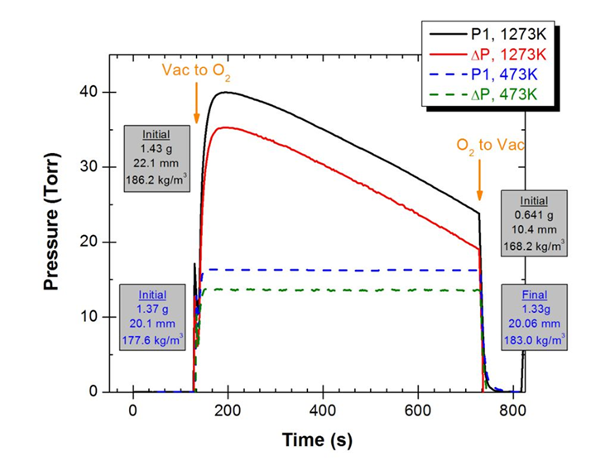
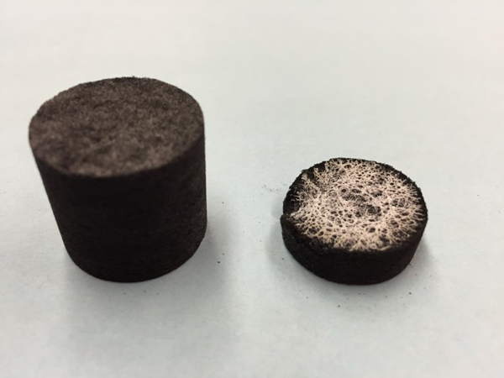
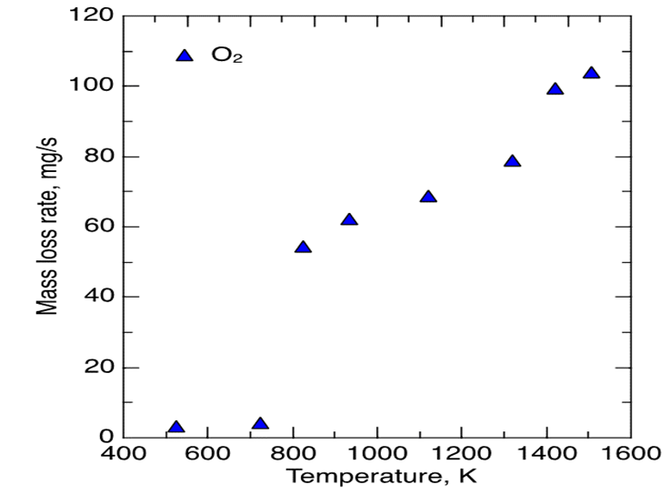
O2 Experiments
Whitish material attributed to Ca residue
Upstream Pressure drop
due to recession of plug
Mass loss is temperature dependent

Slide 12
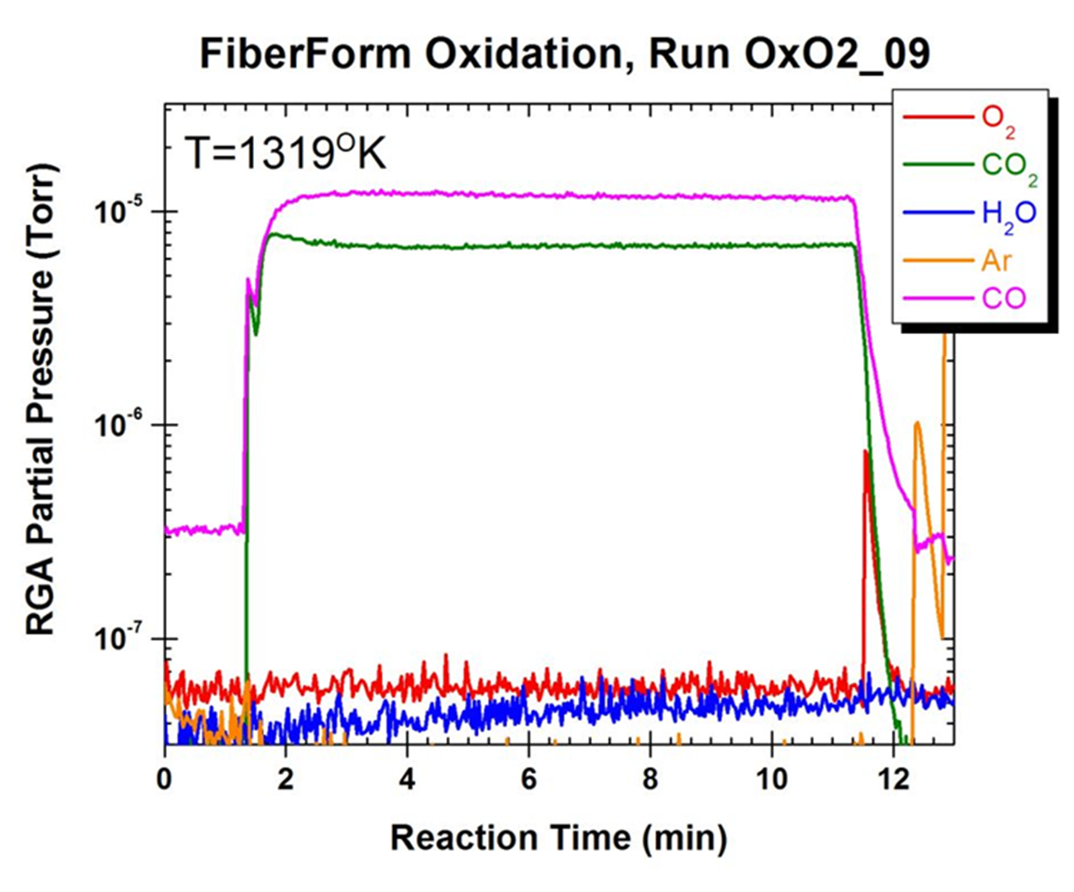
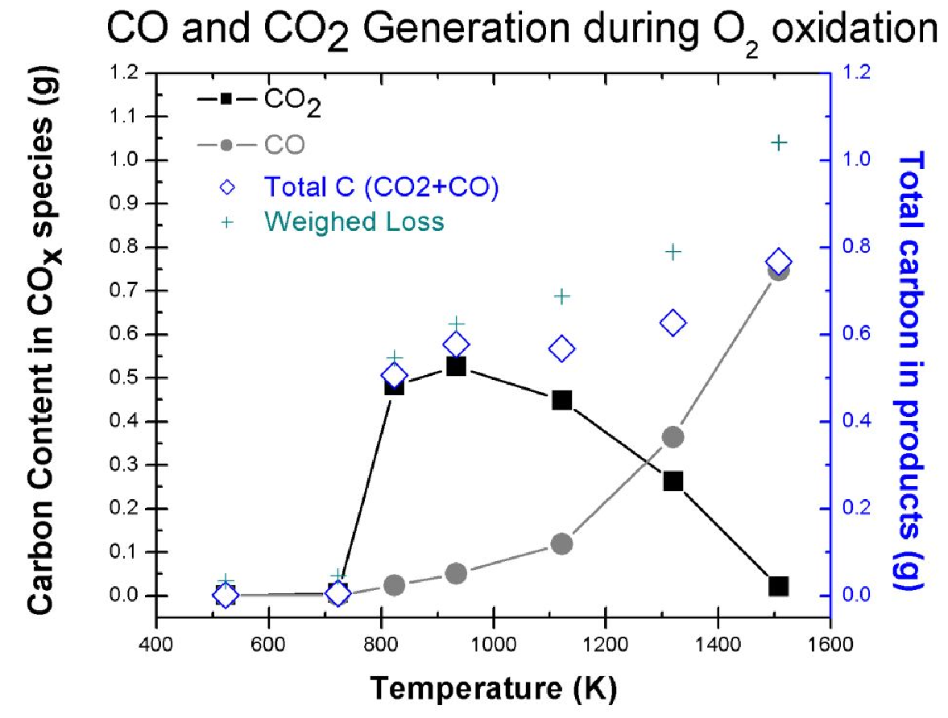
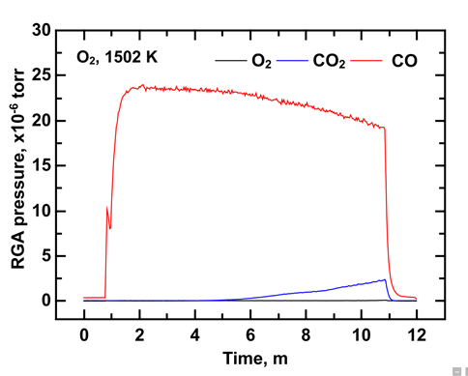
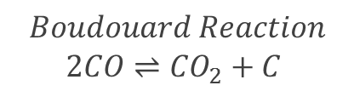
O2 Experiments
$$Boudouard Reaction$$
$$2CO⇌{CO}_{2}+C$$

Slide 13
NO Experiments
Titration: N+NO→N2+O
Products due to O must be distinguished from those due to NO;
NO’s chemical interaction with the plug must be determined
Initial experiments were the standard 10 minutes long
Mass loss was very small, increase sensitivity to measurement by increasing experiment time
 | Temperature (C) | Mass Loss (%)
NO | 1250 | 2.8
O2 | 1200 | 58.5
Ar/N2 | 1200 | ~1.9

Slide 14
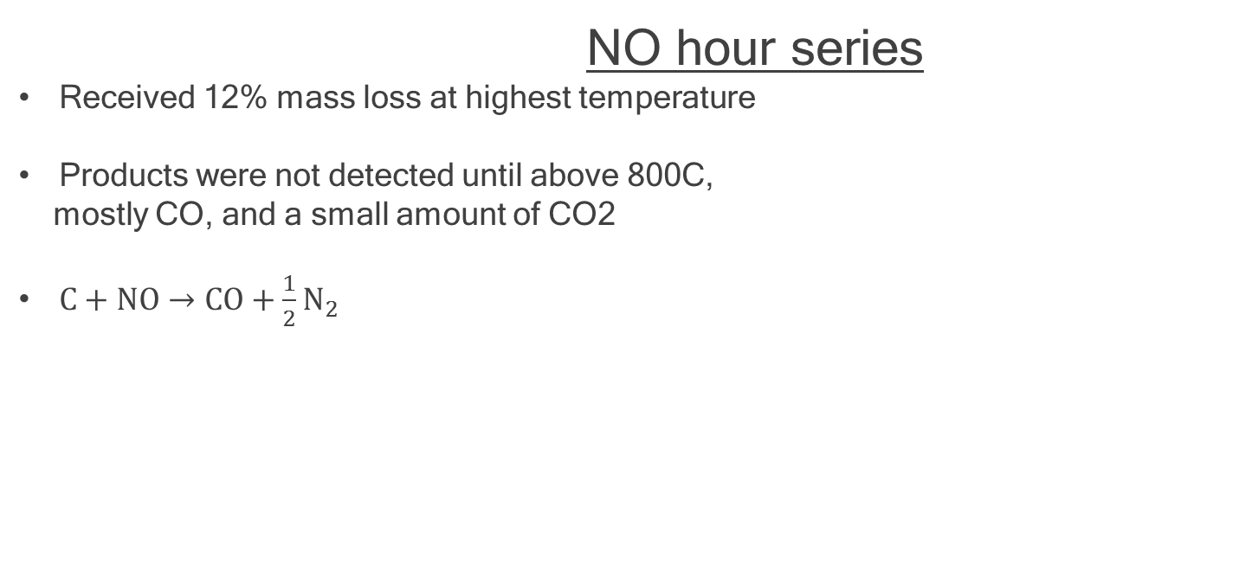
NO hour series
Received 12% mass loss at highest temperature
Products were not detected until above 800C,
mostly CO, and a small amount of CO2
$C+NO→CO+{\frac{1}{2}N}_{2}$

Slide 15
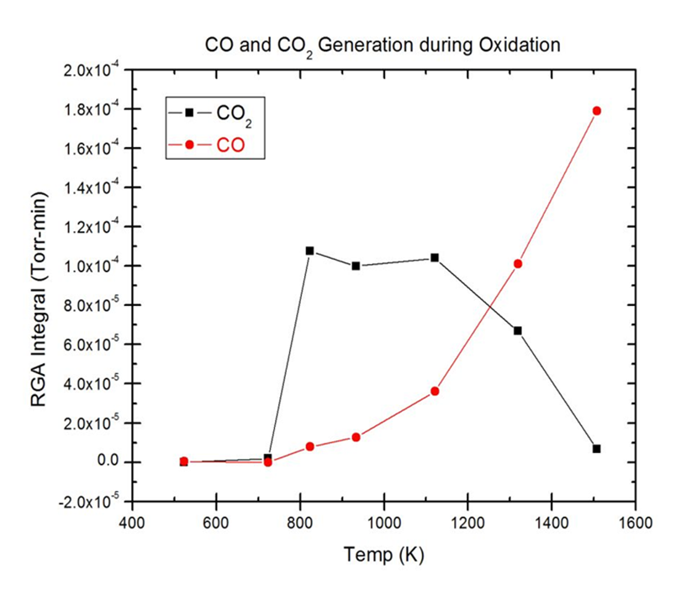
NO hour series

Slide 16
O Experiments
No reaction with the plug was observed during discharge experiments
High pressures may cause recombination O atoms before reaching plug surface
Upstream pressure was lowered using a half plug/in-plane plug, still no reaction
It was shown that at 10 torr, no plug, NO intensity
remained constant during titration
At 3 torr, no plug, N was shown to combine with
NO (no increase in NO signal) during titration
Titration still showed no reaction at 3 torr.

Slide 17
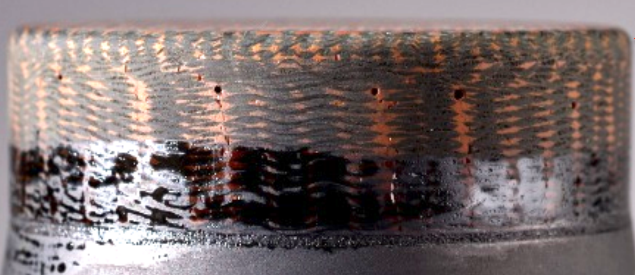
Future Experiments
Improve O experiments
Experiment with pyrolysis gases (phenol, benzene, alcohols, hydrogen, were all produced during pyrolysis experiments of carbon/phenolic material here at SRI)
Perform experiments with PICA instead of Fiberform, as well as with conformal ablative materials.
MF vs intensity→ integrate time vs intensity→ mass of carbon show vs wiegthed
←Woven Ablative Material

Slide 18
Acknowledgments
REU Mentor: Jason White
REU Program Manager: Sanhita Dixit
Partners in the lab: Thomas Cochell, UK
and Francesco Panerai, NASA
Thank you

